Slide 1

Deep Learning
NASTARAN SHAHPARIAN |SHARCNET | COMPUTE ONTARIO | COMPUTE CANADA |YORK UNIVERSITY

Slide 2

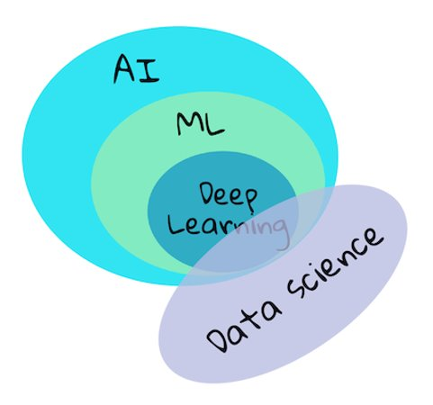
Difference between ML, DL, AI, and Data science
Artificial Intelligence
Any techniques that enables computers to mimic human behaviour
Machine Learning
Ability to learn without explicitly being performed
Deep learning
Extract pattern from data using neural networks

Slide 3
Machine Learning in simple words
Training a machine learning algorithm on a set of data, allowing it to identify patterns and make predictions or decisions based on that data.
A type of artificial intelligence that enables machines to learn from experience without being explicitly programmed.
Has many practical applications, including image and speech recognition, natural language processing, fraud detection, and recommendation systems.

Slide 4

Data is in different forms
Numerical data (Marketing Analytics)
Image data (Face recognition)
Video data (Object recognition)
Sound data (Music generation)
Text data (Sentiment analysis)

Slide 5
ML Workflow
Training Data
ML Trained Model
Training
Input Data
Results
Prediction

Slide 6
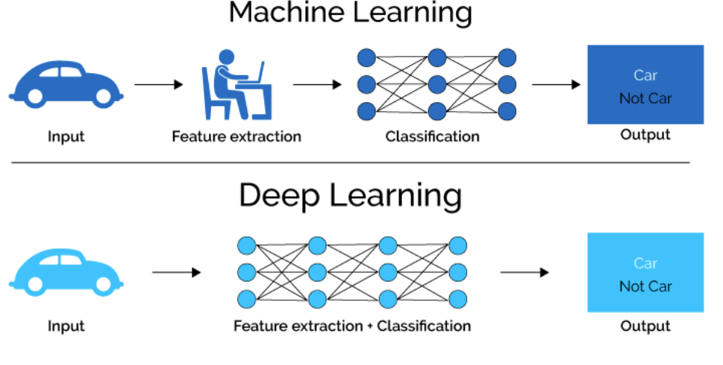
What is Deep Learning?
Deep Learning (DL) is a subset of machine learning
Multiple layers of nonlinear processing units are used for feature extraction and transformation.
A computational approach that involves the use of multiple layers of artificial neural networks to model and solve complex problems.
https://medium.com/swlh/ill-tell-you-why-deep-learning-is-so-popular-and-in-demand-5aca72628780

Slide 7
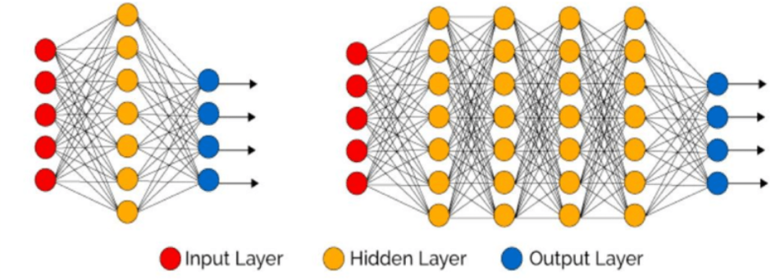
A shallow neural network with single hidden layer
A deep neural network with more than one
hidden layernetwork
https://sourcemeridian.com/machine-learning-as-a-tool-to-grow-sales-in-telemarketing-operations/

Slide 8
What is AI?
Training Data
ML Trained Model
Training
Input Data
Results
Prediction
Feedback loop

Slide 9
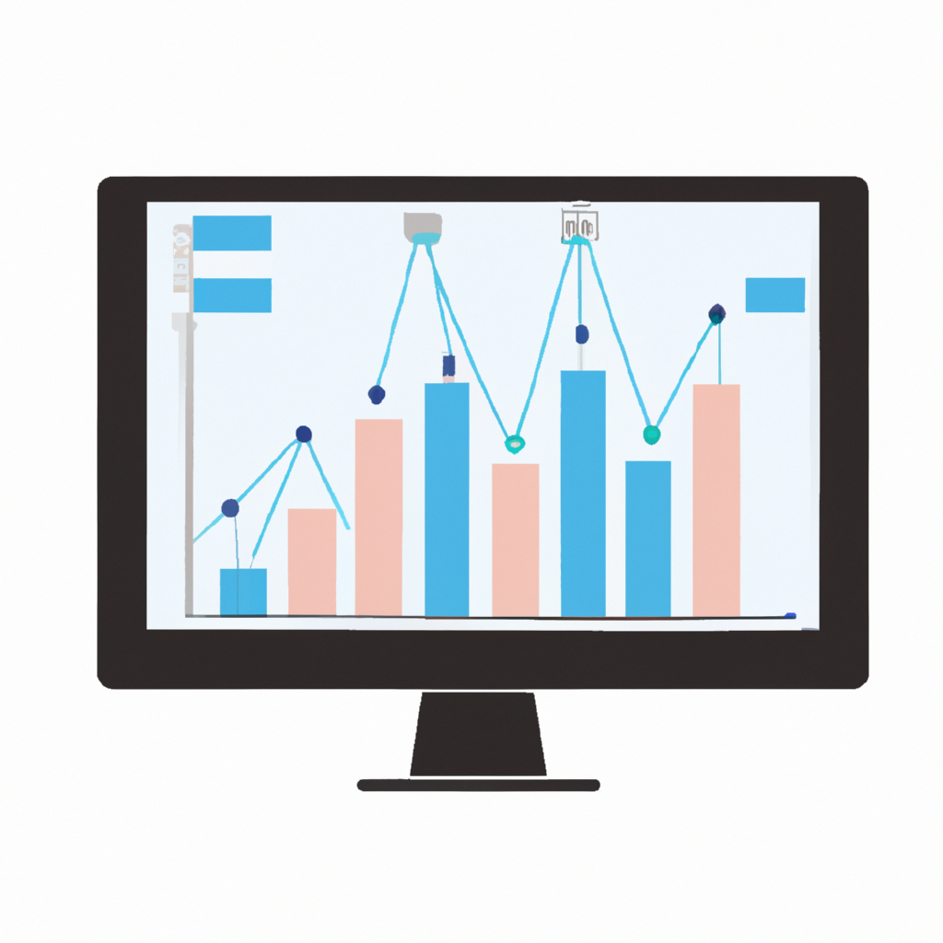
What is Data Science
Data Driven Decision making
Making sense out of data
Uncovering the hidden insights and patterns in data
Using machine learning models, data visualizations and intelligent reports

Slide 10
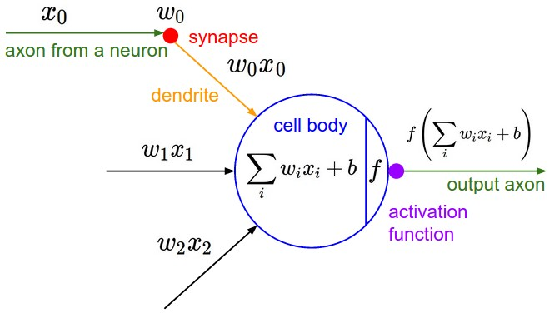
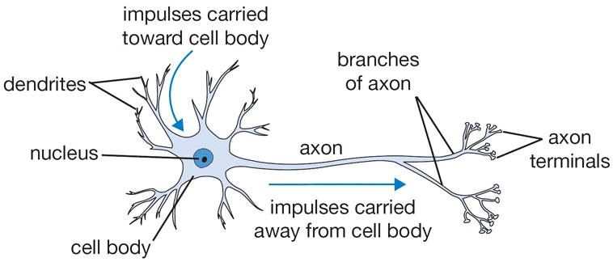
Neural Network
http://cs231n.github.io/neural-networks-1/
https://www.atrainceu.com/content/3-normal-brain-functions-and-normal-aging
https://bouzouitina-hamdi.medium.com/activation-functions-in-neural-networks-1c1de2c866a

Slide 11
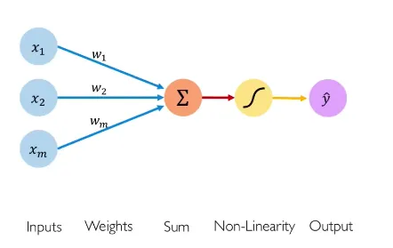
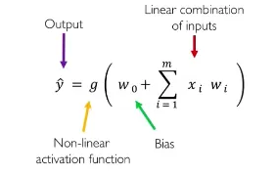
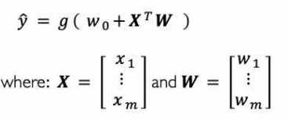
The Perceptron: Forward Propagation
https://medium.com/analytics-vidhya/neural-network-part1-inside-a-single-neuron-fee5e44f1e

Slide 12
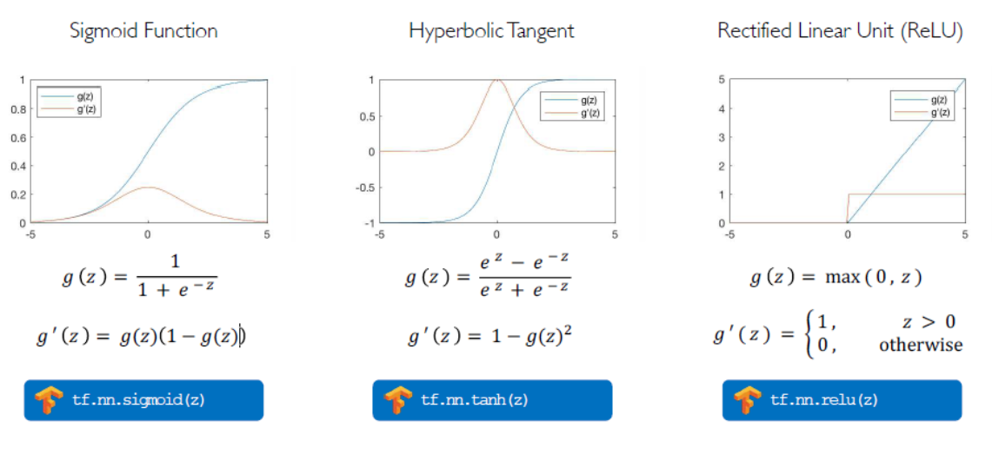
Common Activation Functions
© Alexander Amini and Ava Amini
MIT Introduction to Deep Learning
IntroToDeepLearning.com

Slide 13
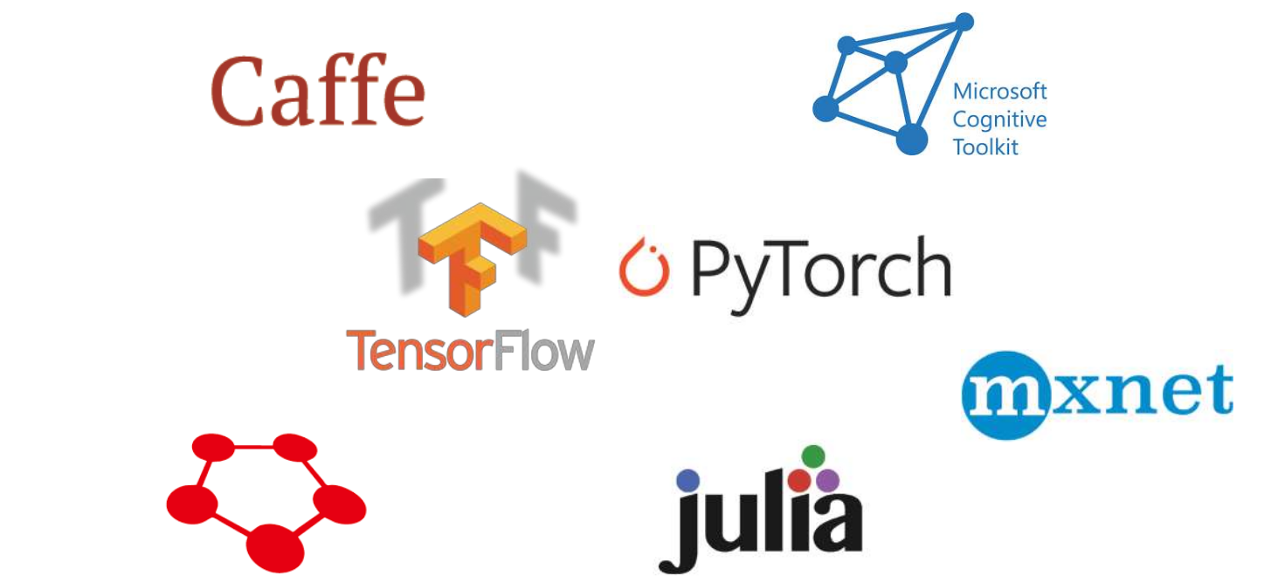
DL Frameworks

Slide 14
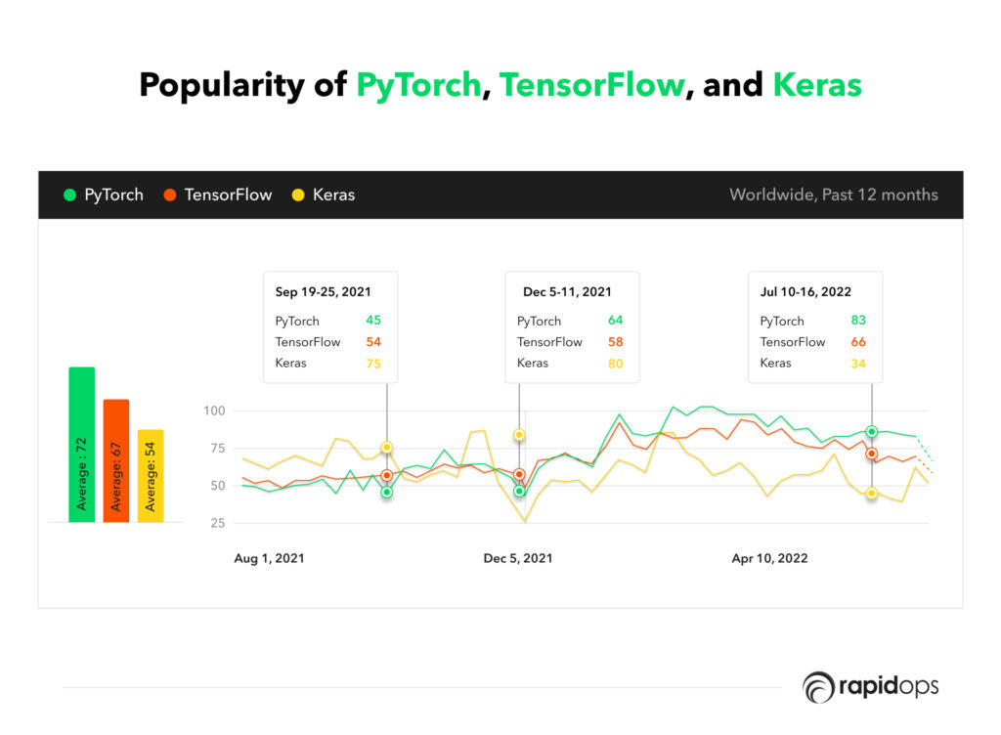
DL Frameworks trends
https://www.rapidops.com/blog/tensorflow-pytorch-keras/

Slide 15
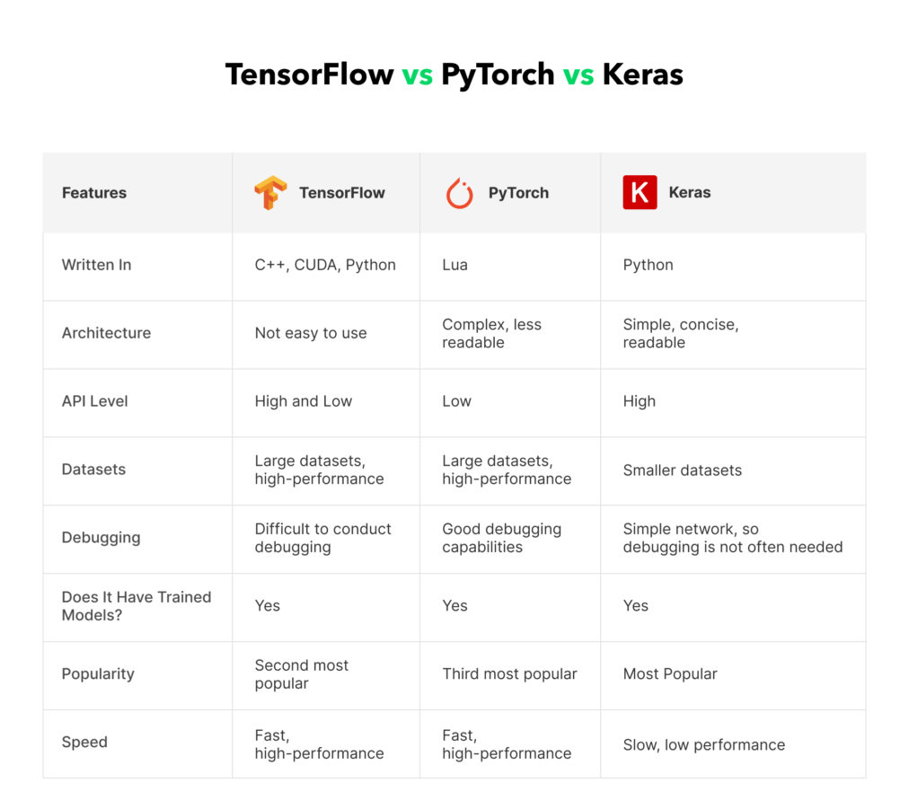
DL Frameworks Comparison
https://www.rapidops.com/blog/tensorflow-pytorch-keras/

Slide 16
ML problems
Types of Machine learning
 | Supervised | Unsupervised | Reinforcement
Discrete | Classification | Clustering | Rewarding/punishing behaviour
Continuous | Regression | Dimensionality reduction | Rewarding/punishing behaviour

Slide 17
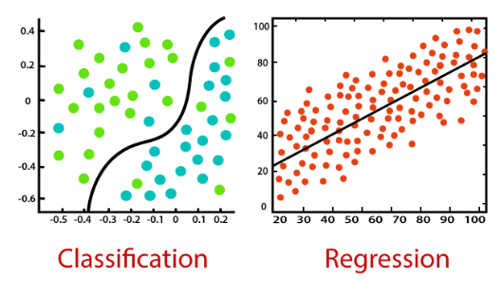
Supervised learning
The algorithm is trained on a labeled datasets to predict unseen data
Regression
Predict a continuous output variable. (The price of a house)
Classification
The algorithm learns to predict a categorical output variable (classifying an email as spam or not spam)
https://www.projectpro.io/article/classification-vs-regression-in-machine-learning/545

Slide 18
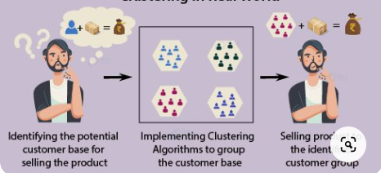
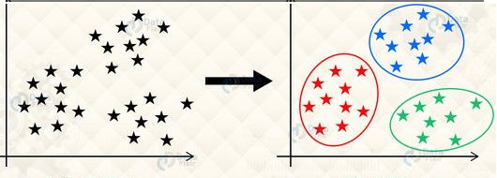
Unsupervised learning
The algorithm is trained on unlabelled data
Tasked with finding patterns on its own, without any feedback
Clustering
Dimensionality reduction
Anomaly detection
https://data-flair.training/blogs/clustering-in-machine-learning/
https://data-flair.training/blogs/scipy-clustering/

Slide 19
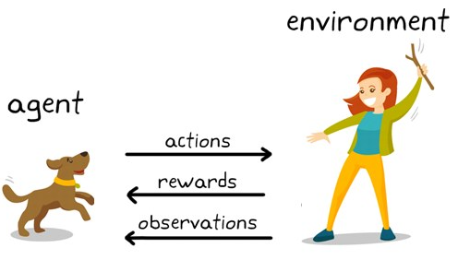
Reinforcement learning
Rewarding desired/ punishing undesired behaviours
Able to perceive and interpret its environment, take actions and learn through trial and error
https://medium.com/analytics-vidhya/a-beginners-guide-to-reinforcement-learning-and-its-basic-implementation-from-scratch-2c0b5444cc49

Slide 20
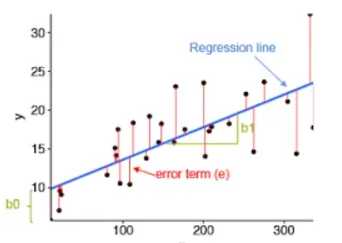
Regression Problem
Find the best-fitting mathematical function that describes the relationship between the variables.
This line best fits the data and minimizes the sum of the squared differences between the actual values of y and the predicted values of y.
https://data-science-blog.com/blog/2022/05/02/understanding-linear-regression-with-all-statistical-terms/

Slide 21
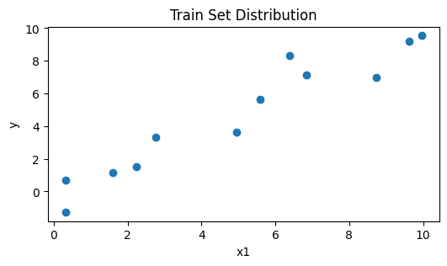
Input (X,y)
X | y
9.62 | 5.94
8.74 | 3.33
2.76 | 11.5
6.38 | 8.76
9.95 | 2.32
5.58 | 8.25
1.59 | 7.69
0.32 | 8.18
4.94 | 5.64
6.83 | 8.16
2.23 | 4.83
0.32 | 5.41

Slide 22
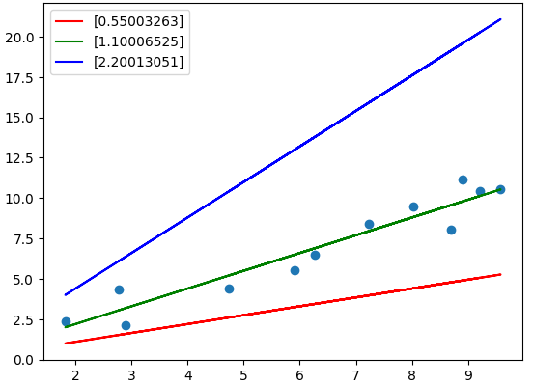
Cost Function
H(x) = Wx+b
Which line fits better?
H(x) -y
Predicted True

Slide 23


Cost Function
Model
H(x) =Wx + b
Mean Square Error
M : number of data
We want to minimize this equation

Slide 24
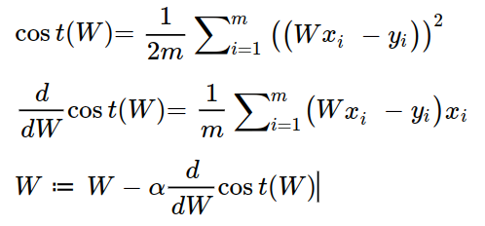
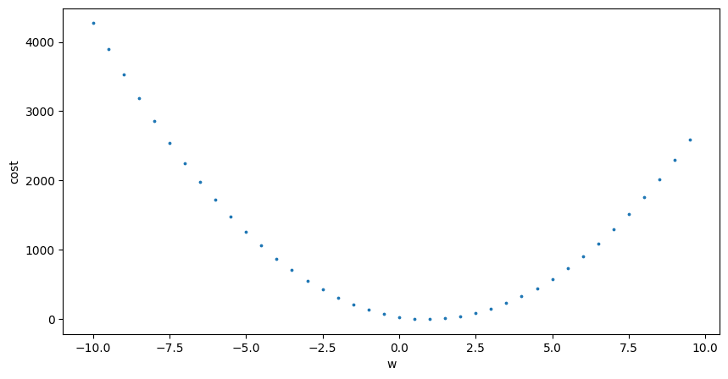
Gradient descent algorithm
Starting point
Starting point
New learning rate

Slide 25

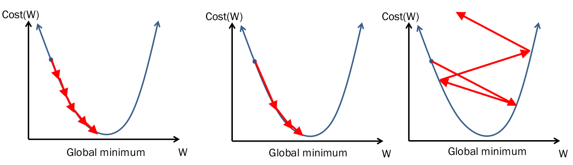
Learning rate
A small learning rate requires time to diverge
An optimal learning rate
Too large learning rate cause divergence
https://medium.com/swlh/cyclical-learning-rates-the-ultimate-guide-for-setting-learning-rates-for-neural-networks-3104e906f0ae

Slide 26

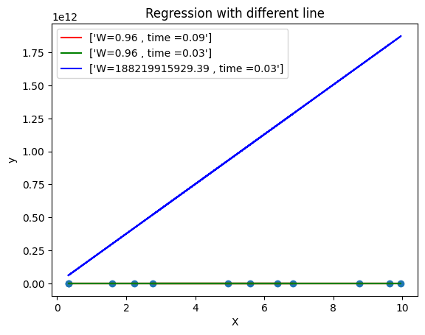
Regression with different Learning rates

